Slide 1
Dutch research on drought in relation to European drought policy
Remco van Ek – remco.vanek@deltares.nl
Drought and low flows, including groundwater
NHV international conference, Maastricht

Slide 2
Overview
European Drought Policy
Dutch research on water scarcity and droughts
International projects
Conclusion

Slide 3
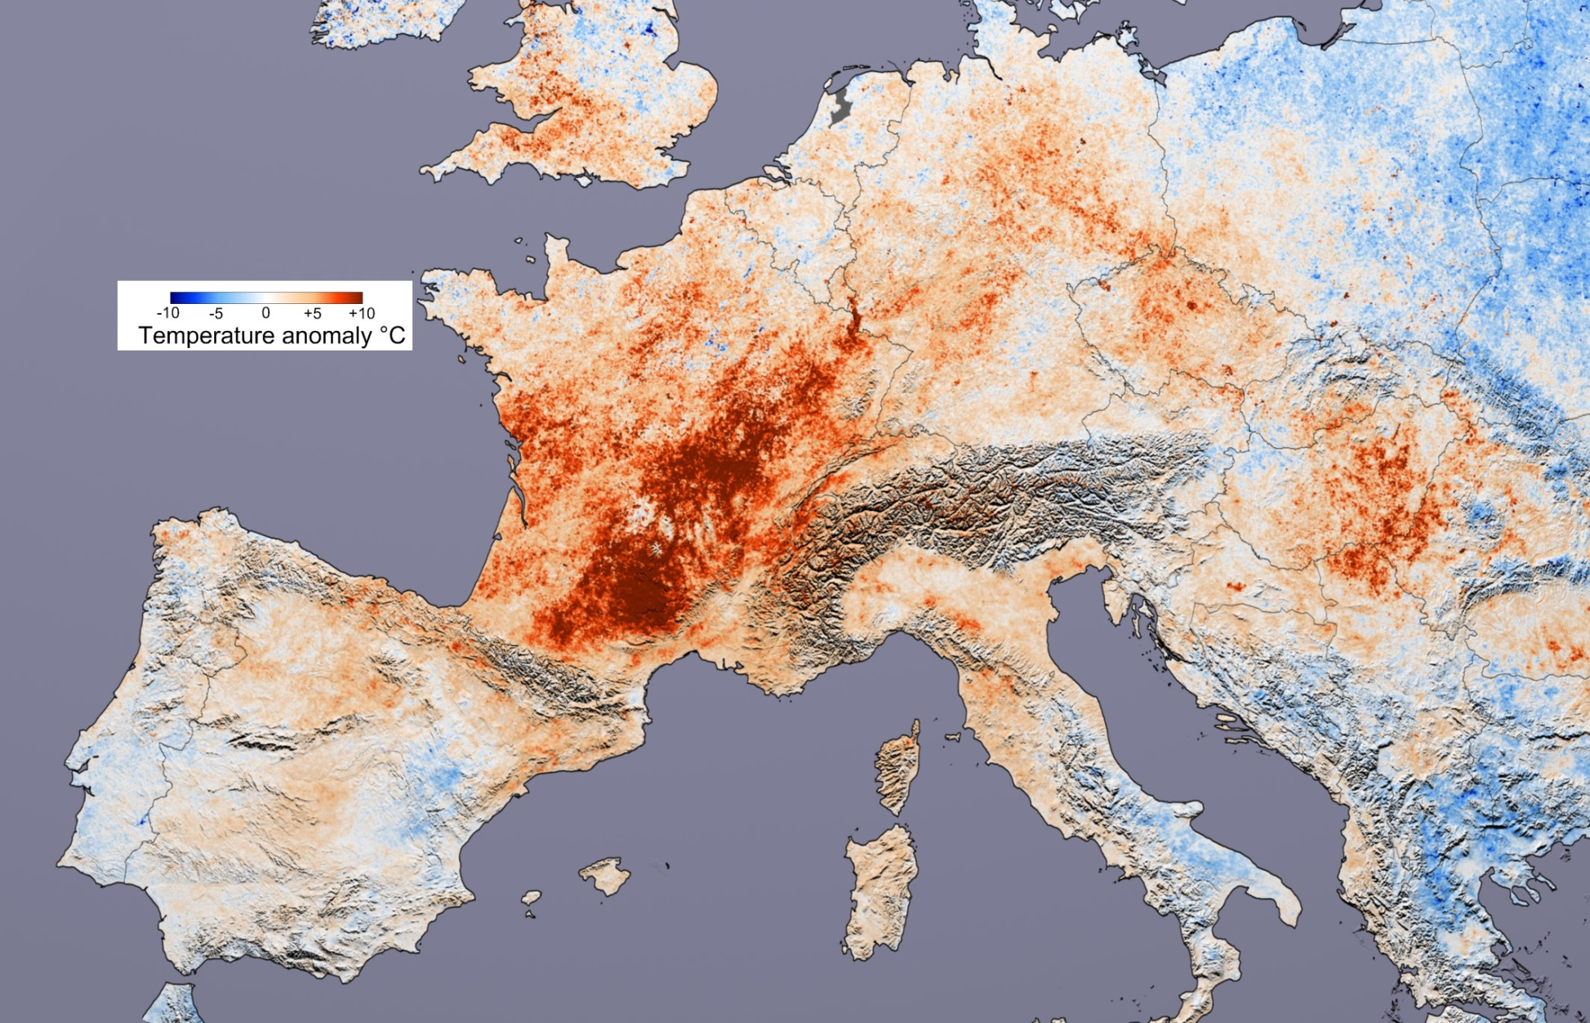
1. European Drought Policy
2003
Heat wave
Image courtesy Reto Stockli and Robert Simmon, based upon data provided by the MODIS Land Science Team

Slide 4
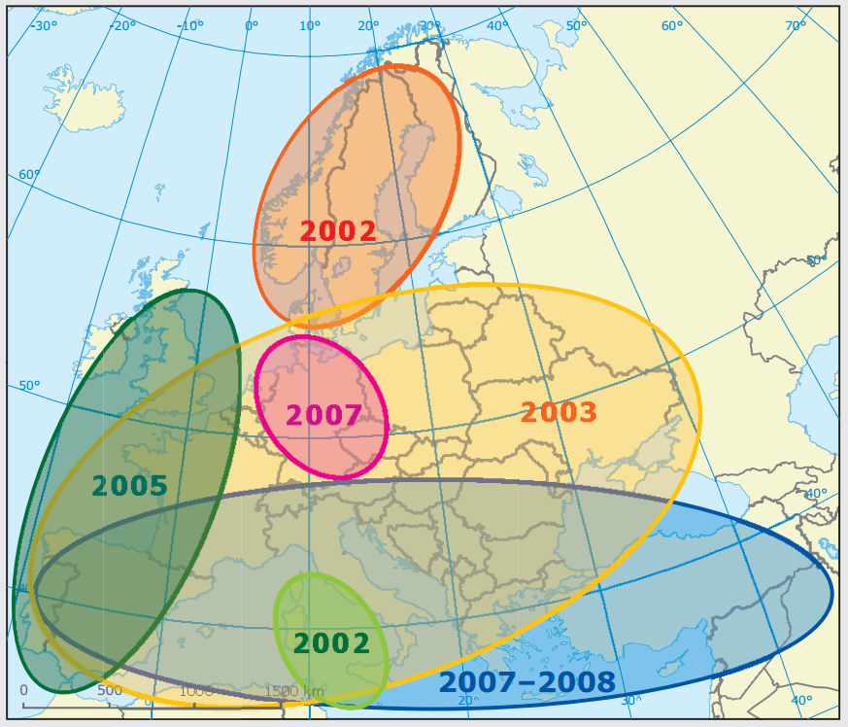
1. European Drought Policy
Main drought events
in Europe 2000-2009
Large areas of EU
Growing concern
Costs: 100 billion euro
in 1976-2006
2003
100 mln affected,
Costs 8.7 bln euro
Adapted from Tallaksen, 2007

Slide 5
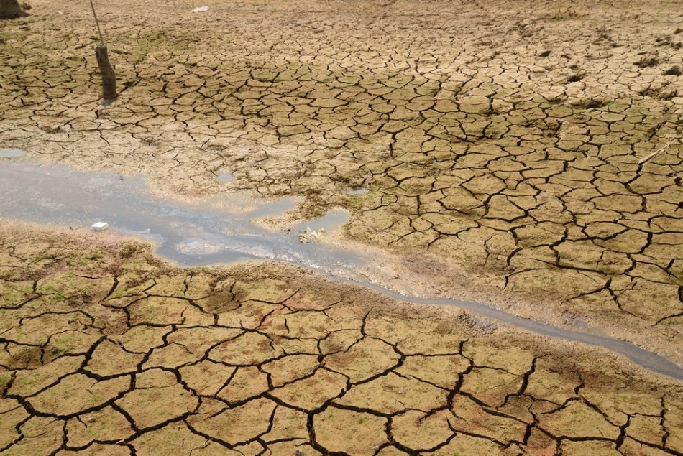
1. European Drought Policy
2006 / 2007 | In-depth assessment of water scarcity and droughts in the European Union
2007 | Communication on WS&D
2008, 2009, 2010 | Follow-up reports “Addressing the challenge of water scarcity and droughts in the European Union”
2012 | Blueprint – policy review WS&D

Slide 6
1. European Drought Policy
Communication EU commission (COM/2007/0414 final)
towards a water-efficient and water-saving economy
General objectives
Address the increasing impacts of water scarcity and droughts
Ensure the long-term protection of available water resources
Ensure sustainable water availability and promote sustainable water uses
Specific objectives:
Enhance preparedness for increasing droughts
Mitigate all impacts of water scarcity and droughts on the environment, economy and society
Create conditions for sustainable economic and social development across Europe in a context of climate change and increasing water scarcity and droughts

Slide 7
1. European Drought Policy
Communication 2007 (COM/2007/0414 final)
Water hierarchy: First increase water efficiency,
before increasing water supply infrastructure
7 policy instruments / options
Putting the right price tag on water
Improving drought risk management
Fostering water efficient technologies and practices
Fostering the emergence of a water-saving culture
Allocating water & water-related funding efficiently
Considering additional water supply infrastructures
Improve knowledge and data collection
Barcelona drought 2008
Ancient church emerges from flooded valley for first time in 50 years during

Slide 8
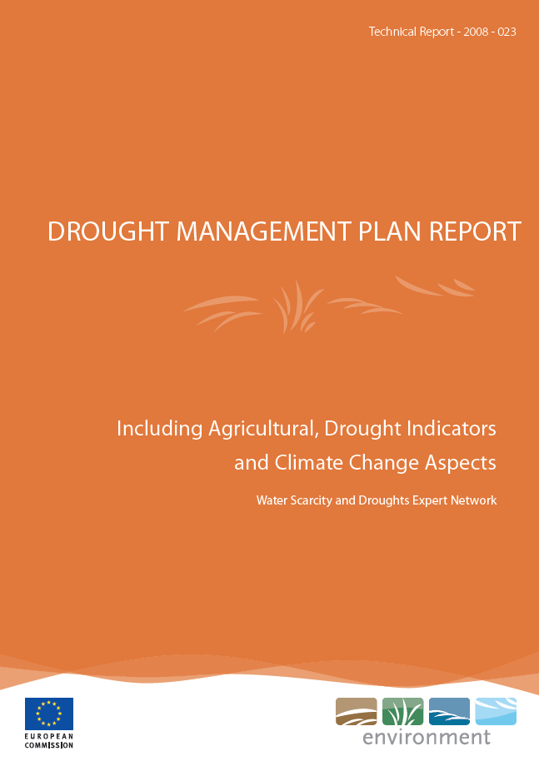
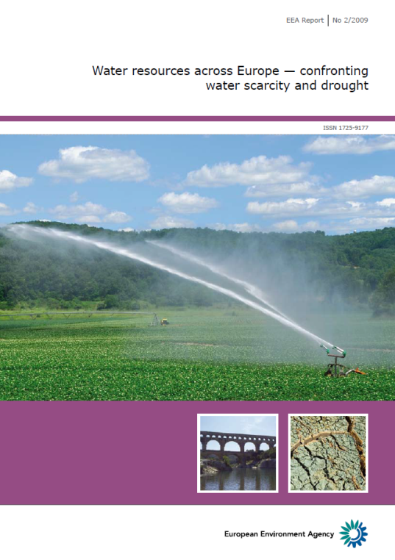
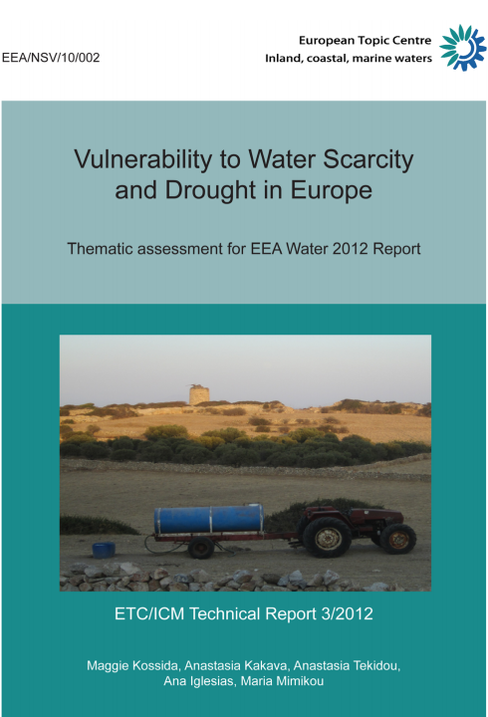
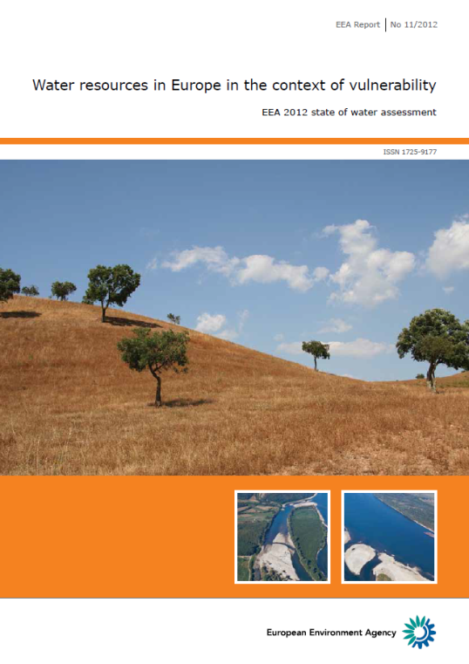
1. European Drought Policy
Common Implementation Strategy (CIS)
2006-2012 Water Scarcity and Droughts Expert Network
Knowledge exchange, EEA technical assistance
Linkage with WFD: Agriculture, Groundwater, DMP
2007-2009 indicators → WS&D knowledge system (EDO)
2008
2009
2012
2012

Slide 9
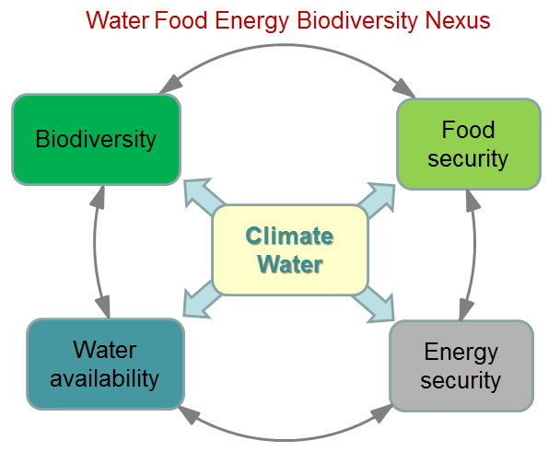
1. European Drought Policy
Blueprint 2012 – Policy review
Objectives 2007 (revert WS&D trends) not achieved
Next WFD cycle: further integration of water quantity issues into sectoral policies

Slide 10
2. Dutch research on droughts
R&D on WS&D? Many organizations involved on many subjects!
… therefore an overview, but not complete …
Topics
Problem analysis, impacts (models)
Planning (policy, management)
Data management (water accounting)
Interpretation (indicators)
Early warning systems
Global Water Services
Integrated Water Resource Management
Innovative measures
Monitoring and evaluation
Governance
Scale
Local – Regional – National - Global
Sector
Drinking water, Agriculture, Transport, Nature, Urban
Technology
Water technology, Delta technology, Agro technology
Institutes
Deltares, WUR/Alterra, KNMI, KWR, ...

Slide 11
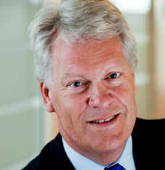
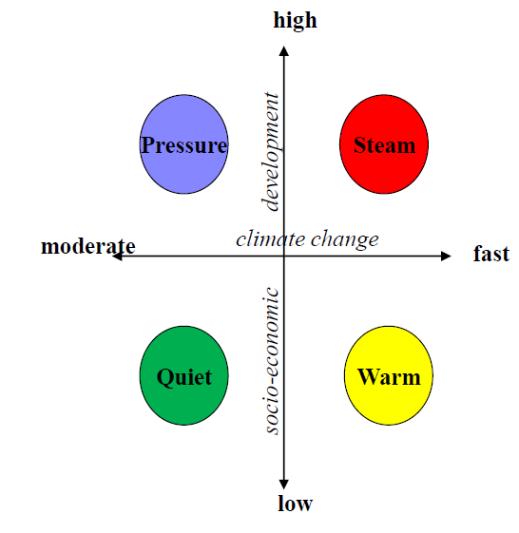
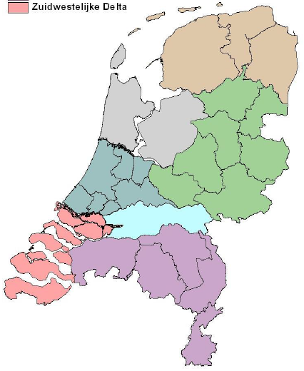
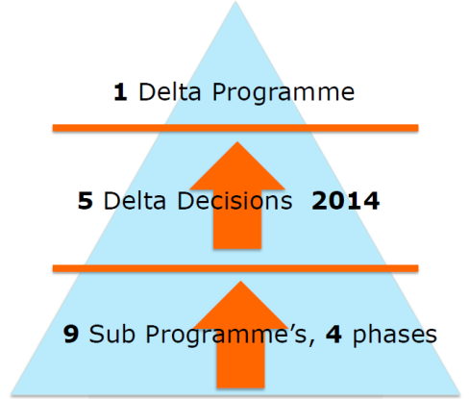
2. Dutch research on droughts Policy analysis, impacts
Delta programme: sub-programme freshwater
Nation wide analysis of water scarcity and droughts
Goal: Sustainable freshwater management, now and in 2050
Task:
Develop strategies for freshwater management in the NL
Identiy short term (2015) no-regret measures
State
Provinces
Waterboards
Municipalities
Sectors
Knowledge institutes
Programme 2009-2014
Delta scenarios
Collaborative assessment

Slide 12
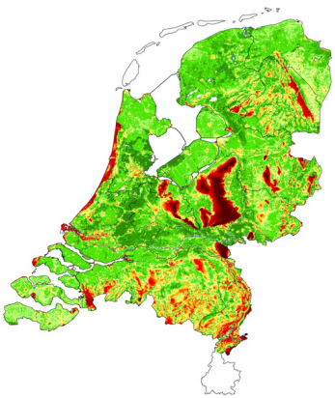
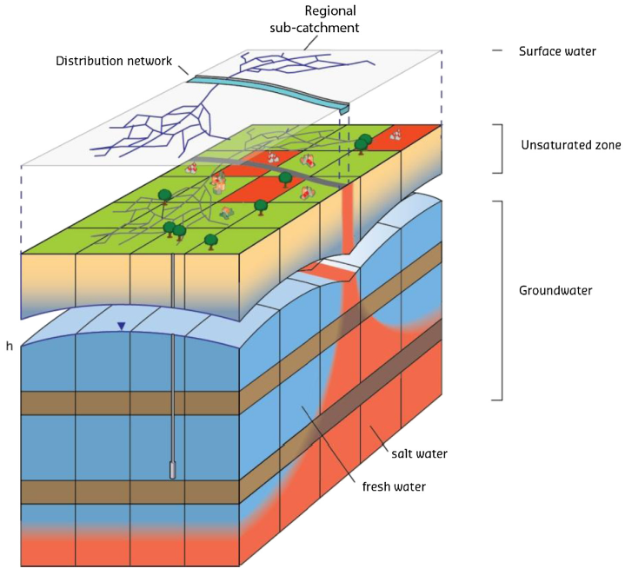
2. Dutch research on droughts Policy analysis, impacts
Delta programme: sub-programme freshwater
National Hydrological Instrument
Water balance of subcatchments and main surface waters
Salt in surface waters
Fluxes and heads in unsaturated and saturated groundwater
Salt concentration in saturated groundwater and salt flux to surface water
www.nhi.nu
De Lange et al., 2014
doi.org/10.1016/j.envsoft.2014.05.009

Slide 13
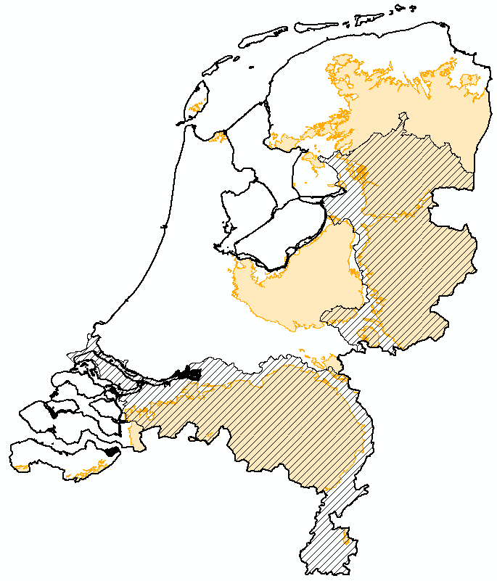
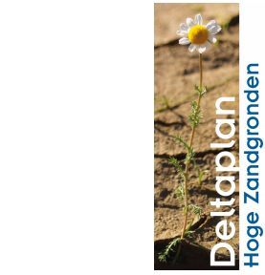
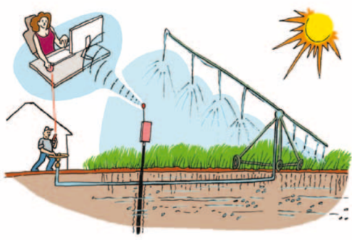
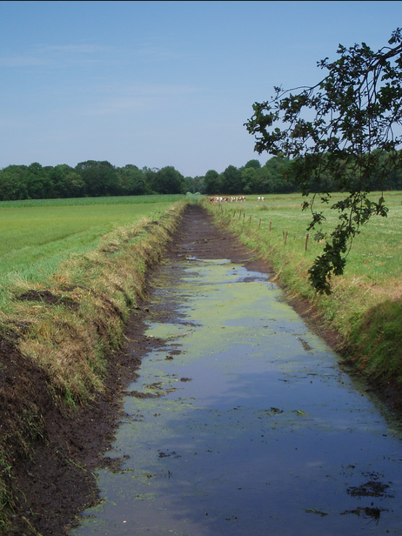
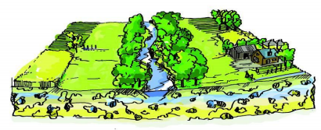
2. Dutch research on droughts Policy analysis, impacts
ZON
DHZ
Deltaplan High Sandy Soils (2009-2014)
Goal: climate proof, sustainable regional water system (WS&D)
Bottleneck analysis
Climate adaptation strategies
Learn from ‘Best practices’
High-precision irrigation
Improving soil water storage
Collected drainage
New water regime Limburg
Broad brook valleys
Water retention at the source
Orientation on ‘Next practices’

Slide 14
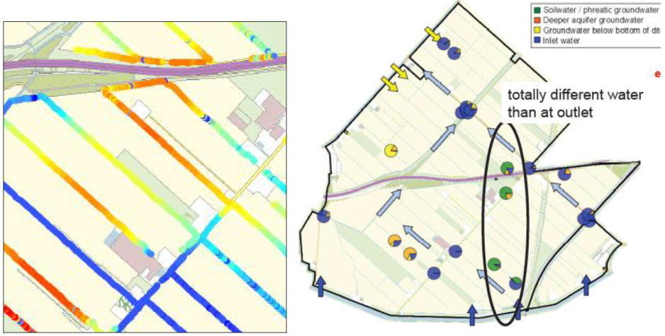
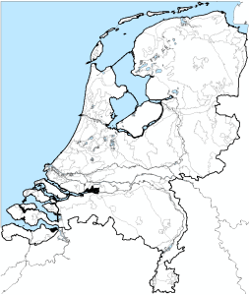
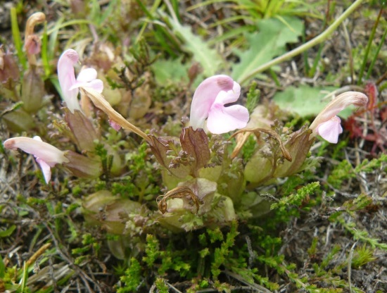
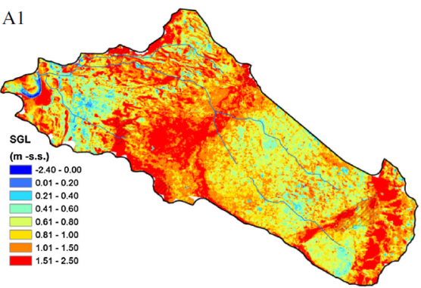
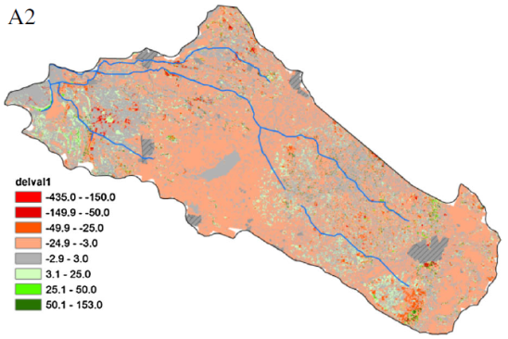
2. Dutch research on droughts Policy analysis, impacts
Knowledge for climate: freshwater & rural areas (2010-2014)
Salinisation in deep polders
http://knowledgeforclimate.climateresearchnetherlands.nl/climateprooffreshwater
Boils
Ecohydrological impacts
http://knowledgeforclimate.climateresearchnetherlands.nl/climateadaptationforruralareas
Groundwater
Vegetation
Biodiversity
Witte et al., 2014 DOI 10.1007/s10980-014-0086-z

Slide 15
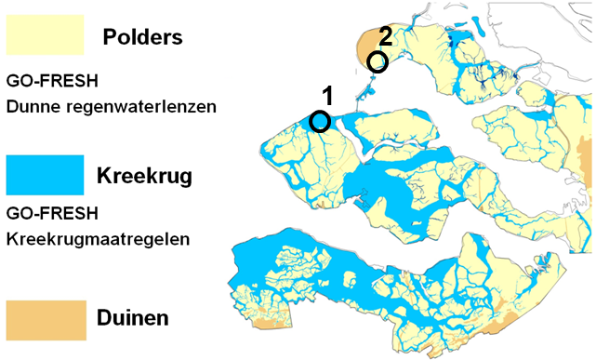
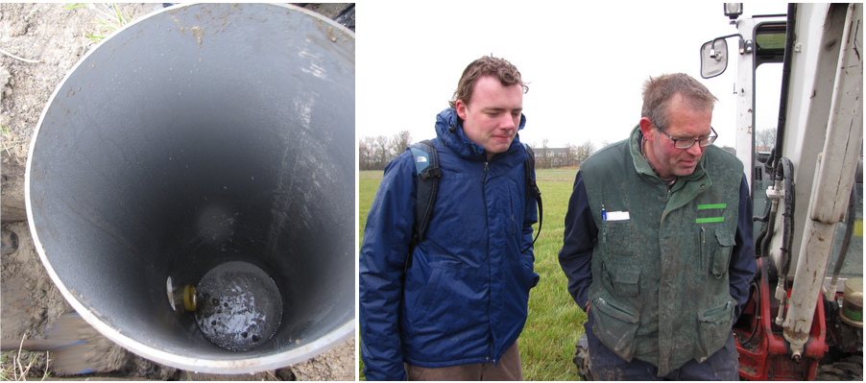
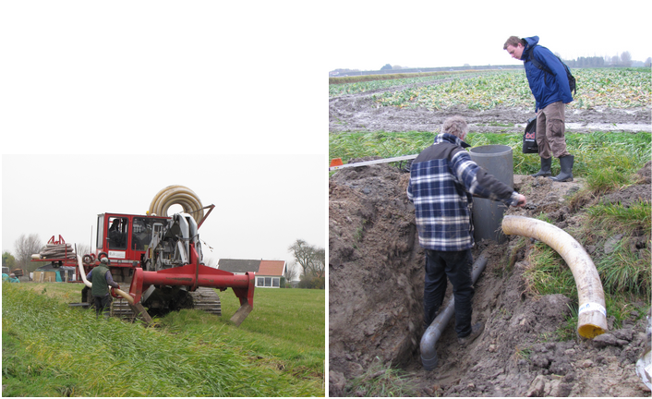
2. Dutch research on droughts Innovative measures
Go-Fresh project – Geohydrological Opportunities FRESH water supply
Polders
Thin rainwater lenses
Sandy ridges
Aquifer recharge
Dunes

Slide 16
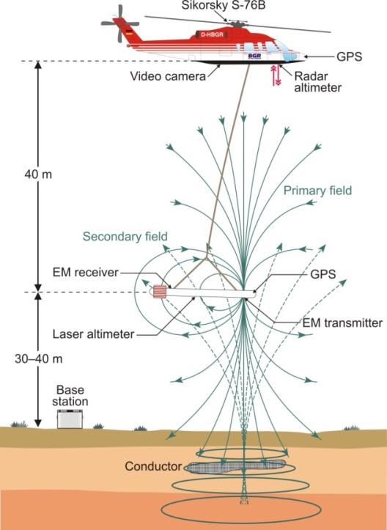
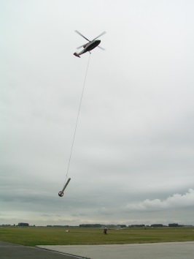
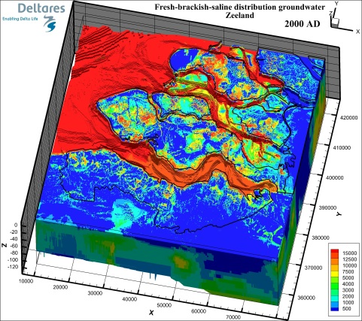
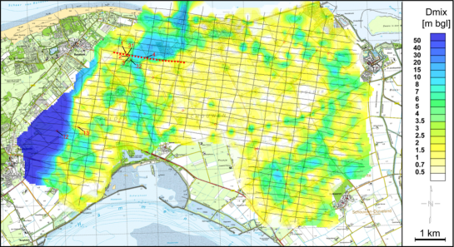
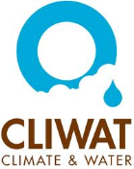
2. Dutch research on droughts Monitoring and evaluation
FRESHEM – FREsh Salt groundwater distribution by Helicopter Electro Magnetic survey
Rapid reconnaissance of Province of Zeeland (2014 – 2016)

Slide 17
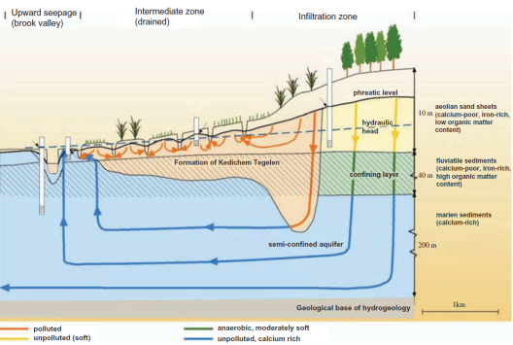
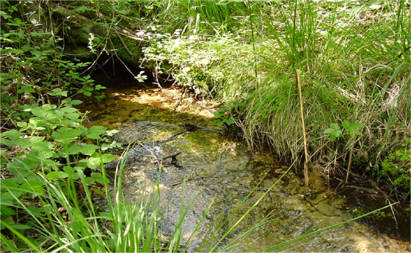
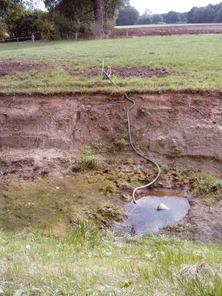
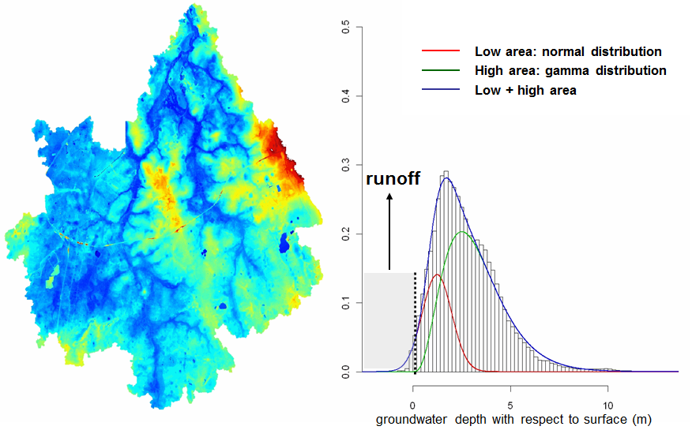
2. Dutch research on droughts Modelling, impacts
Groundwater – surface water interaction, low flows
Impact analysis on ecological flow
Lowland Groundwater Surface water Interaction model (LGSI)
Modelling of CC impacts and measures
More low flow conditions are expected
Small streams are vulnerable
Hydrological measures can be effective
Hendriks et al., 2014 doi:10.1080/02626667.2014.892601
Dynamic metamodel GW depth & discharge
Geohydrological characteristics in regional
DSS for low flow predictions
Van der Velde et al., 2009 doi:10.1007/s10980-014-0086-z
Wanders et al., 2011. Deltares report 1203833

Slide 18
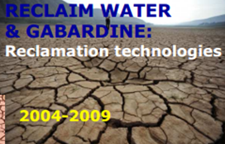
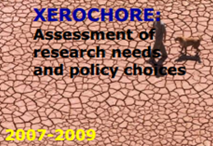
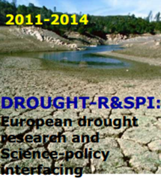
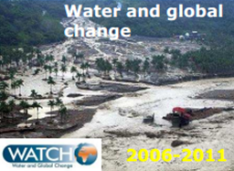
3. International drought projects
EU projects
Plan
Policy
development
Act
Design of
policy
Do
Policy
Implementation
Check
Policy
review

Slide 19
3. International drought projects
European Drought Centre www.geo.uio.no/edc
Virtual centre of European drought research and drought management organisations to promote collaboration and capacity building between scientists and the user community
EU Watch www.eu-watch.org
Extensive analysis of the world’s water resources
Xerochore www.feem-project.net/xerochore
synthesize knowledge on past, current and future drought events
compile a roadmap providing ST+LT research needs to support implementation of drought management plans within WFD
2006-present
2007-2011
2007-2009

Slide 20
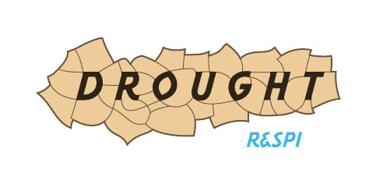
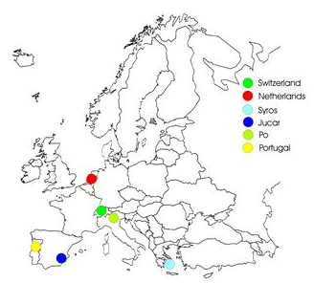
3. International drought projects Policy analysis, impacts, governance
Drought R&SPI www.eu-drought.org Oct 2011- Sep 2014
Aims:
Better understanding of past droughts
Better understanding of impacts
Evaluation of past policy responses
Innovative suite of drought indicators
Innovative methodology for early warning
Drought hazard at the pan-European scale in the 21st Century
Potential vulnerabilities at different scales in the 21st Century
Dialogue Fora at different scales, i.e. Science-Policy Interfacing
Dissemination (EDC, Summer School, Conference)
case studies

Slide 21
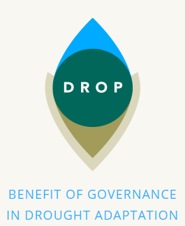
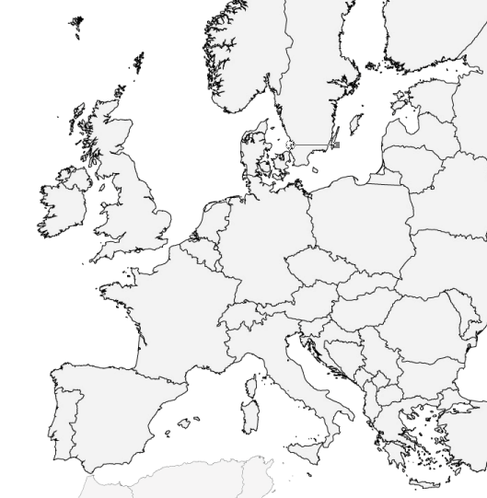
3. International drought projects Measures, governance
DROP - Benefit of governance in DROught adaPtation
Interreg IVB project www.dropproject.eu
Goal: to enhance the preparedness and resilience of Northwest European (NWE) regions to periods of water scarcity and drought
Testing and implement innovative measures in 6 case areas
Develop and test water governance assessment tool
Collaboration between six regional water authorities (practice partners) and five knowledge institutes (knowledge partners)
2013-2015

Slide 22
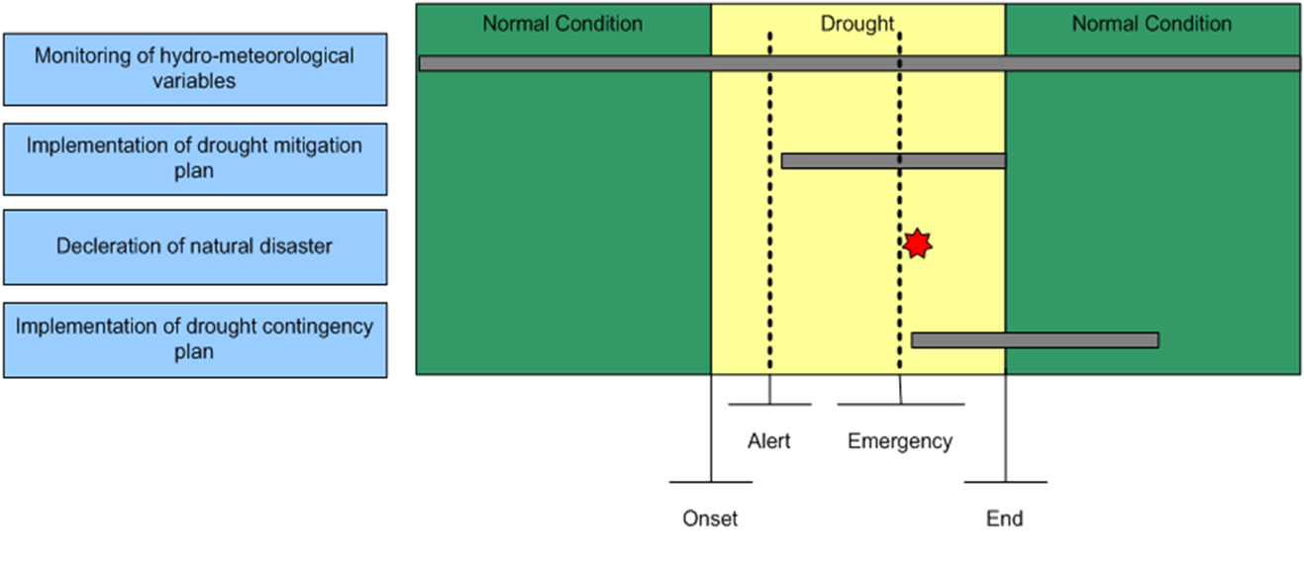
3. International drought projects Early warning systems
DEWFORA - Improved Drought Early Warning and FORecasting to strengthen preparedness and adaptation to droughts in Africa
Goal: develop a framework for the provision of early warning and response through drought impact mitigation for Africa. The whole chain from monitoring and vulnerability assessment, to forecasting, warning, response, and knowledge dissemination

Slide 23
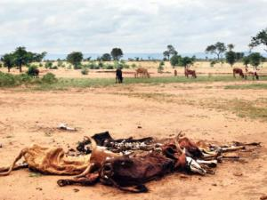
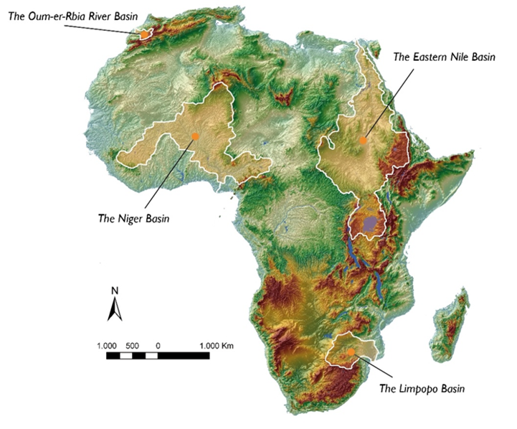
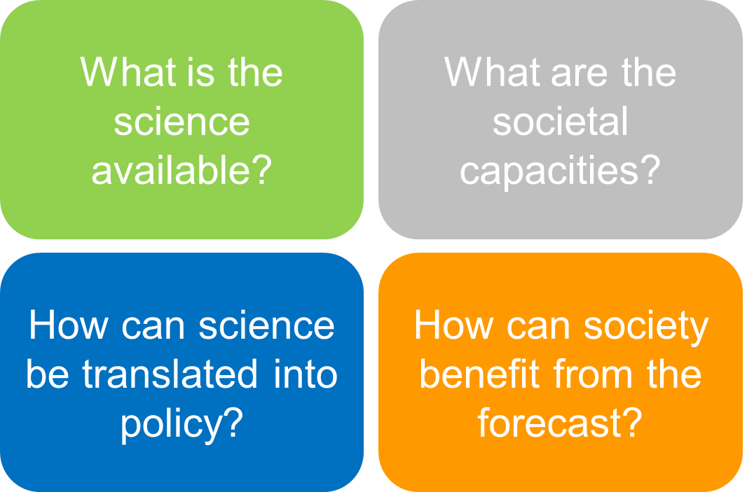
3. International drought projects
5 river basins (2011-2013)
Protocol for developing
Drought Early Warning

Slide 24
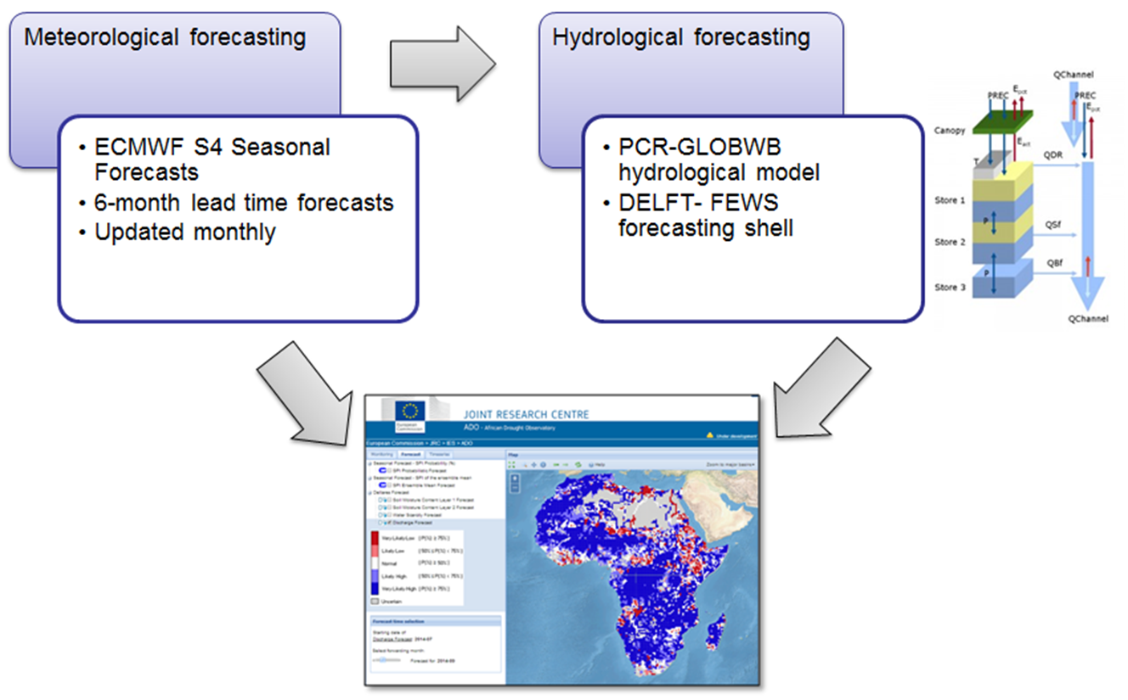
3. International drought projects Early warning systems
African Drought Observatory: pre-operational drought forecasting platform

Slide 25
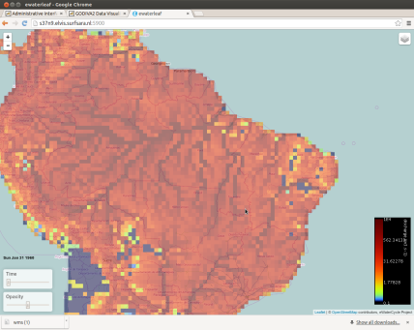
3. International drought projects Global water services
Global Water Information services
Disclosure of data and information on water supply and demand for policy makers, water managers and research communities
Web based tools/info, open data portal
Model predictions (e.g. PCR-GLOBWB) for future scenarios
International collaboration (e.g. JRC)
2011-2013
www.globalhydrology.nl
www.glowasis.eu
2014-2017
www.earth2observe.eu
2014-..
www.ewatercycle.nl
Improving and extending global data sets
Improving models towards high resolution and
high performance

Slide 26
4. Conclusion
Water scarcity and droughts is a growing concern in the EU
NL is a wet country but attention for WS&D is growing
NL carries out many projects to prepare for future WS&D
Dutch water community (knowledge institutes, public authorities) is well connected to EU research on WS&D, and outside EU … (e.g. Asia, Africa, Latin-America)

