Slide 1
Water and nature
Remco van Ek, remco.vanek@deltares.nl

Slide 2
Content
Introduction on myself
Nature protection in the Netherlands
Nature and water quantity: desiccation
Nature and water quality
Nature and climate change
Ecosystem services, management
Knowledge development
Lessons learned

Slide 3
1. Introduction on myself
Biologist, University of Amsterdam
Academic background: system ecology, physical geography
Tropical Forest Ecology
Atmospheric deposition on Dutch forest
Professional background: Nation wide policy analysis on groundwater dependent terrestrial ecosystems
Project leader DEMNAT
National Research Program on desiccation
Projects on groundwater dependent ecosystems (values, impact)
Implementation of groundwater aspects within the WFD
Sr Advisor/ Researcher / Program manager at Deltares (Fresh water supply)

Slide 4
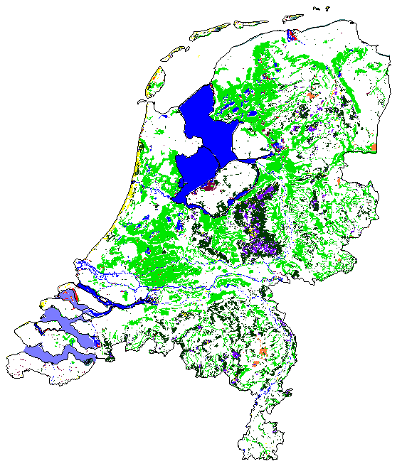
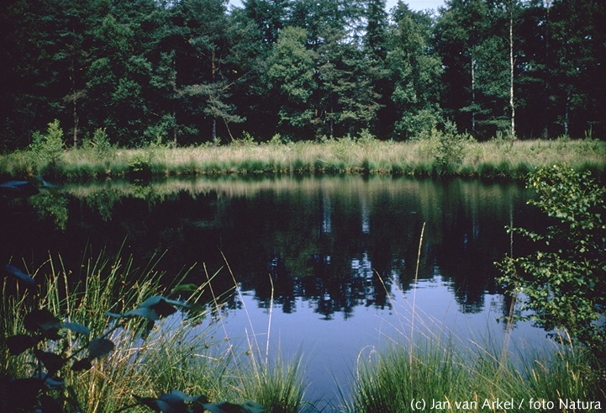
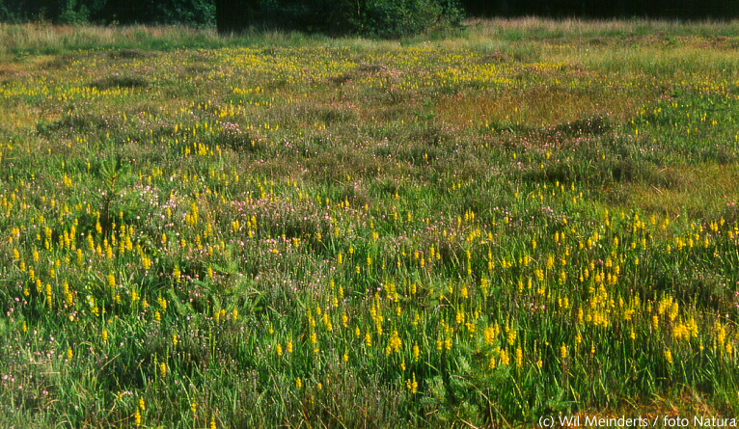
2. Nature protection in the Netherlands
What kind of groundwater dependent nature in the Netherlands?
ponds
Ecosystem types
wet pastureland
bog
fen
heath land*
coastal dunes*
forest*
* = incl. dry types
wet heather/bogs

Slide 5
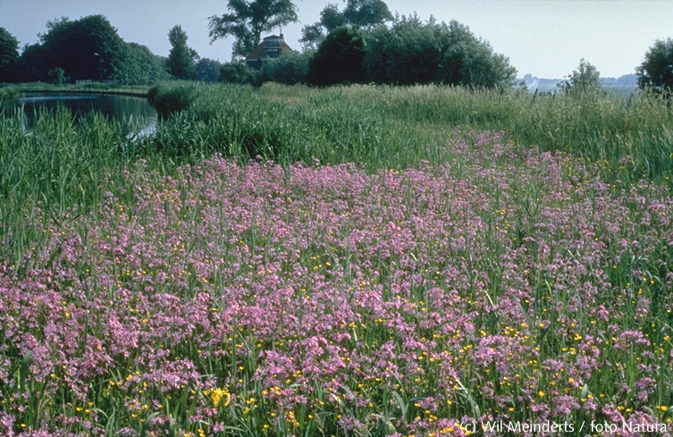
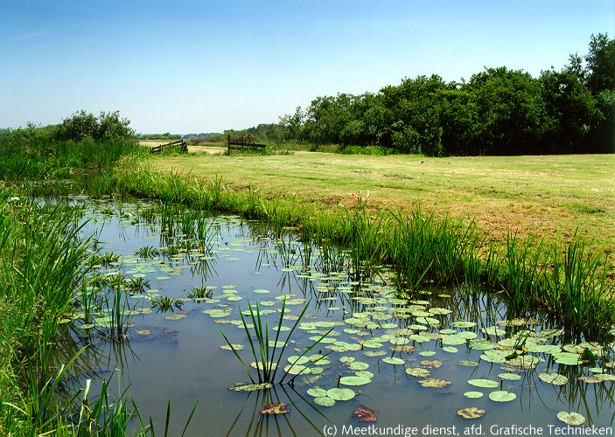
2. Nature protection in the Netherlands
What kind of groundwater dependent nature in the Netherlands?
brook valleys
Ecosystem types
wet pastureland
bog
fen
heath land*
coastal dunes*
forest*
* = incl. dry types
peatlands

Slide 6
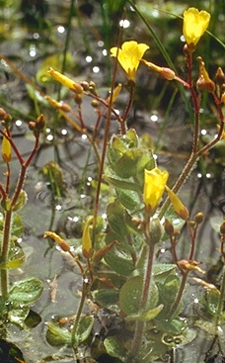
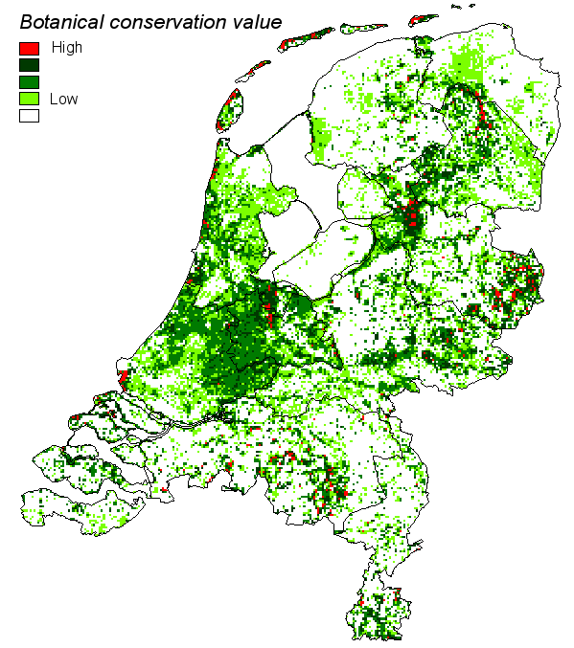
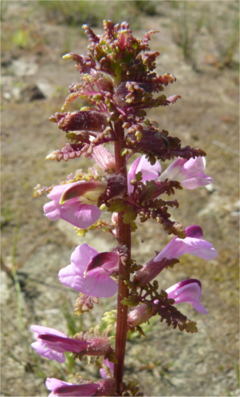
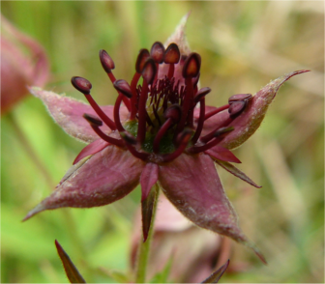
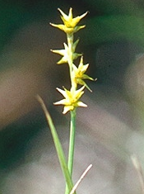
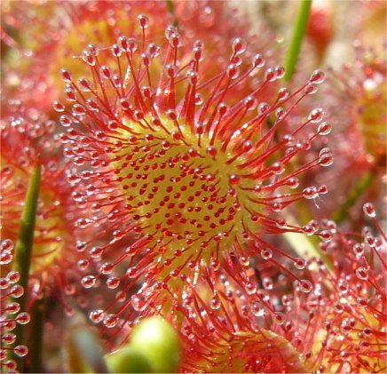
2. Nature protection in the Netherlands
Groundwater dependent nature in NL
Botanical conservation values

Slide 7
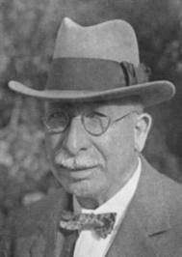
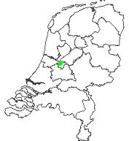
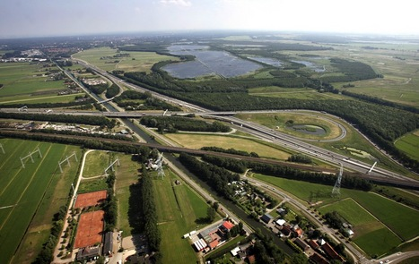
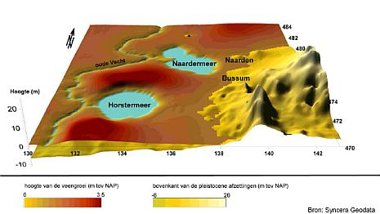
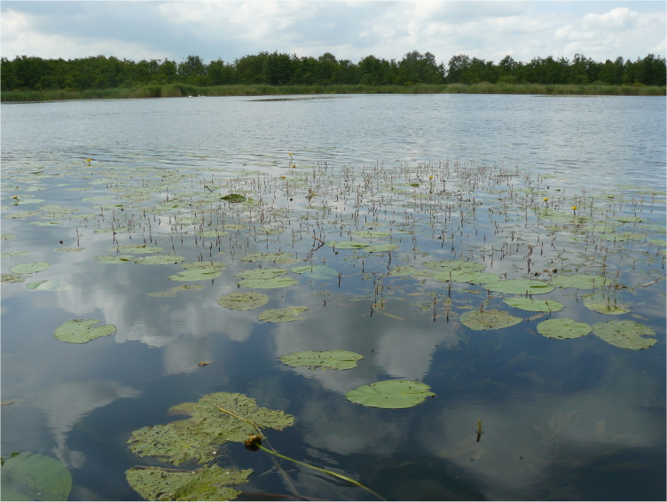

2. Nature protection in the Netherlands
1905 – First nature protection area: Naardermeer
Jac P Thijsse

Slide 8
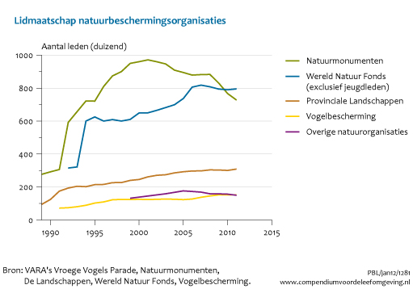
2. Nature protection in the Netherlands
2010
Natuurmonumenten (750.000 members): 355 areas, ~1000 km2
Provincial Landscapes (300.000 members): 800 areas, ~1000 km2
Staatsbosbeheer (government agent): 137 areas, 2600 km2

Slide 9
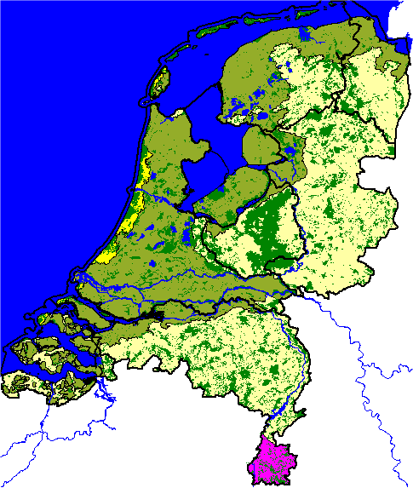
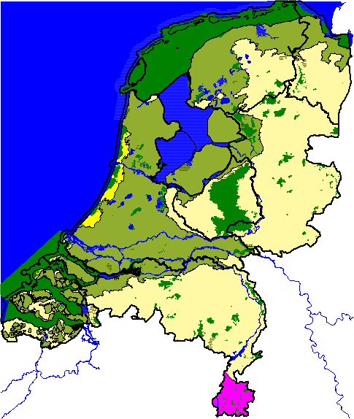
2. Nature protection in the Netherlands
National nature conservation areas
Habitat directive
Bird directive

Slide 10
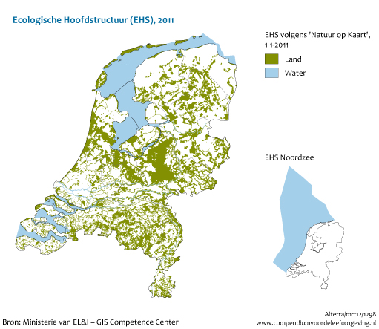
2. Nature protection in the Netherlands
Ecological Main Framework – 7200 km2

Slide 11
3. Nature and water quantity: desiccation
Since 1950’s
Agriculture (drainage, irrigation, manure)
Abstractions (increase 300 -> 1300 Mm³/yr)
Decrease in recharge
  Increase in urban area – sewage systems
  Increase in forested areas – increase in evapotranspiration
  Increase in high yield crops – increase in water consumption

Slide 12
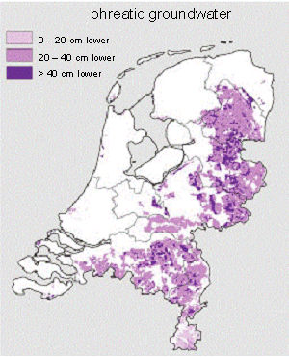
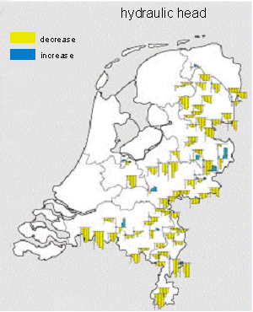
3. Nature and water quantity: desiccation
Hydrological impacts
Decrease in phreatic groundwater level
  Approx. 30 cm over large areas
  Locally > 1 m (pumping wells)
Decrease in hydraulic head
  Decrease in upward seepage flux
Decrease in water levels in lower part of NL
  Increase inlet of ‘system alien’ water
  Adverse effects on water quality

Slide 13
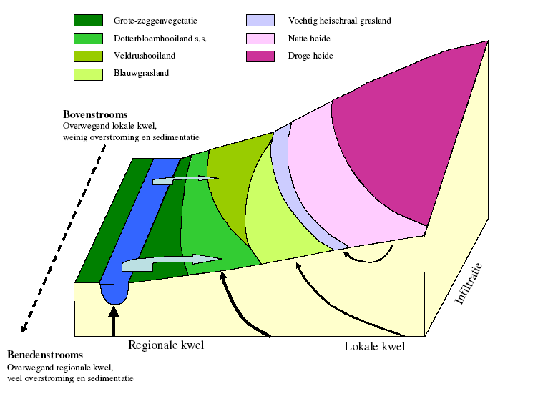
3. Nature and water quantity: desiccation
High sedge vegetation
Caltha pal. meadow
Juncus vegetation
Low sedge vegetation
Wet heathland
Moist heathland
Dry heathland
Upstream
Inundation
Infiltration
Downstream
Regional
upward seepage
Local
upward seepage

Slide 14
3. Nature and water quantity: desiccation
Botanical composition
Vegetation competition
Plant physiology
Site conditions
Aeration
Moisture supply
Acidity
Nutrient status
Management
Lime content
Soil fertility
Fertilitzation
Soil
Moisture content
Capillary
properties
Hydrology
Groundwater
quality
Surface water
quality
Groundwater
level
Upward
seepage
Inundation

Slide 15
3. Nature and water quantity: desiccation
Hydrological impacts → site conditions
HYDROLOGICAL
PHYS. SIOL
ENVIRONMENTAL
CHANGE
PROCESS
STRESS
↓ moisture supply
Lowering of the
Desiccation
groundwater
↑ aeration
level
↑
mineralization
Eutrophication
↑ oxidation processes
Acidification
Increased influence of
rainwater

Slide 16
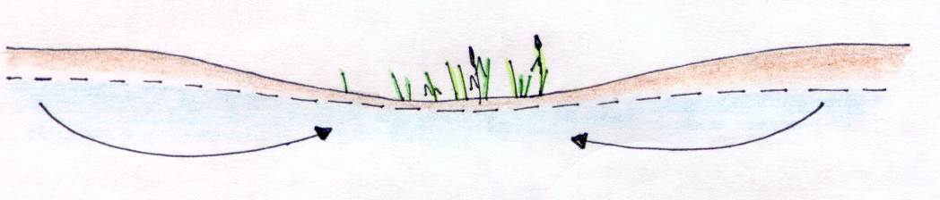
3. Nature and water quantity: desiccation
Ecological impacts
75% of all nature protection areas are moderate or severely affected
Some effects are irreversible…
Upward seepage

Slide 17
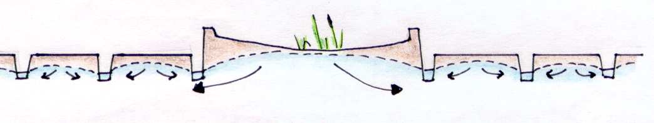
3. Nature and water quantity: desiccation
Ecological impacts
75% of all nature protection areas are moderate or severely affected
Some effects are irreversible…
Infiltration

Slide 18
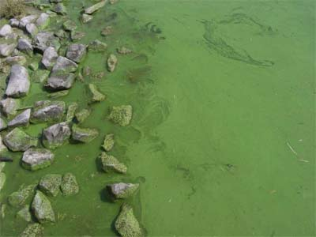
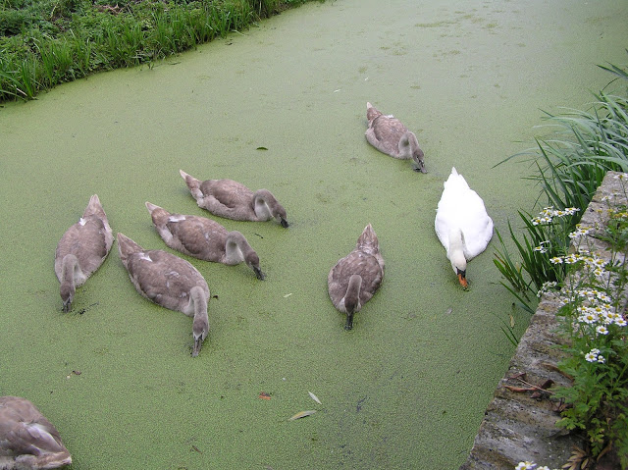
4. Nature and water quality
Since WWII
Increase intensive agriculture
Increase in number of cows, pigs → manure
Eutrophication of surface waters → Alga bloom (Microcystes), Duck weed

Slide 19
4. Nature and water quality
Water Framework Directive (2000/60/EC)

Slide 20
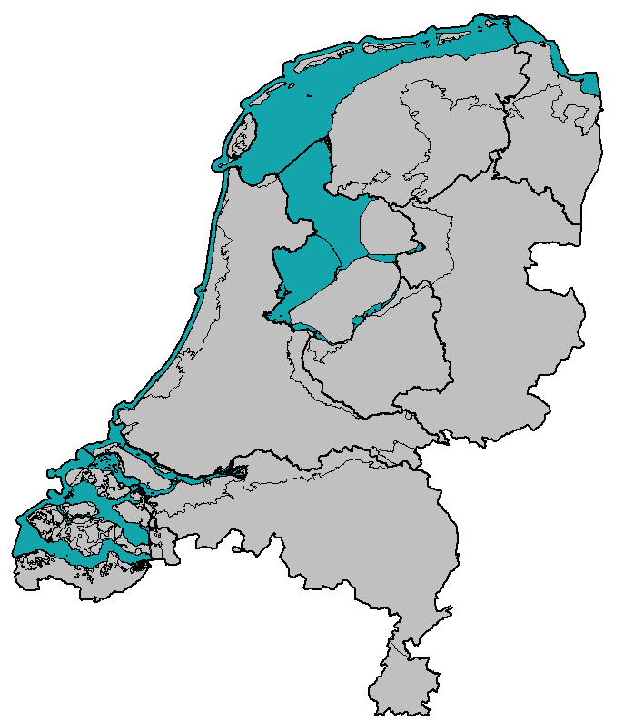
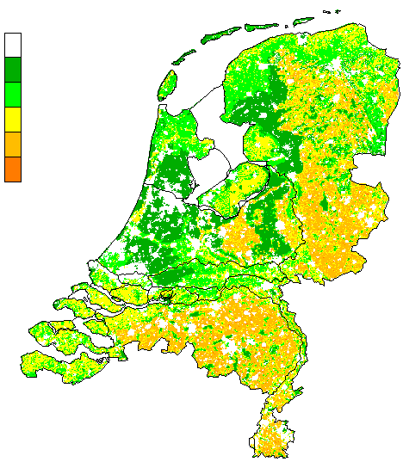
4. Nature and water quality
Since WWII
4. NO3 pollution upper groundwater
50 mg/l = Threshold value
Nitrate conc in upper groundwater
mg/l
Geen data
0 - 25
25 -50
50 - 100
100 - 150
> 150
NO3 can lead to high SO4 load!!!
N₂ _{(g)}
NO₃
Fe₃PO₄ + SO₄ + H₂O
→ Fe²⁺ + PO_{4(aq)} + H₂S
FeS
Fe
SO₄

Slide 21
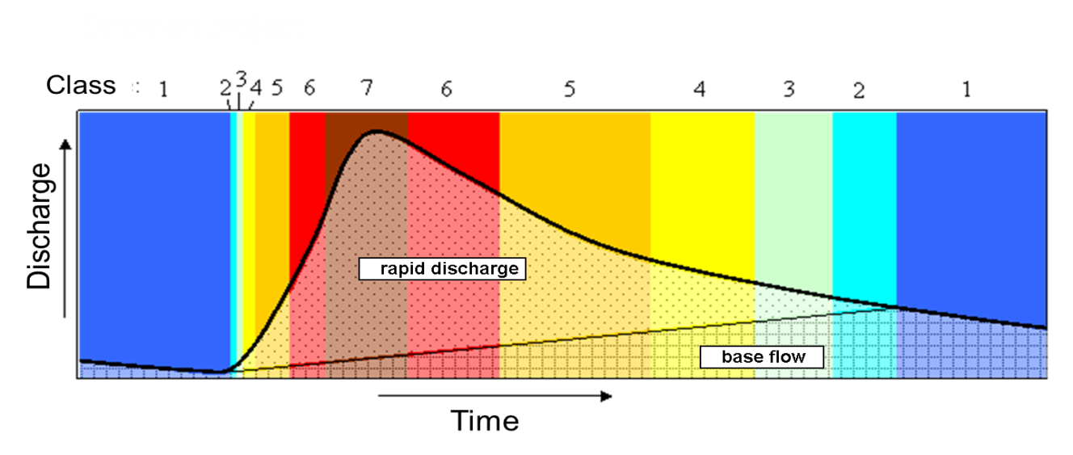
4. Nature and water quality
Interaction between groundwater and surface water:
Rapid discharge
Upper groundwater
Moderate discharge
Shallow groundwater
Base flow
Deep groundwater
Class 1: 100% base flow
Class 2: 0-20% rapid discharge
Class 3: 20-40% rapid discharge
Class 4: 40-60% rapid discharge
Class 5: 60-80% rapid discharge
Class 6: 80-90% rapid discharge
Class 7: 90-100% rapid discharge

Slide 22
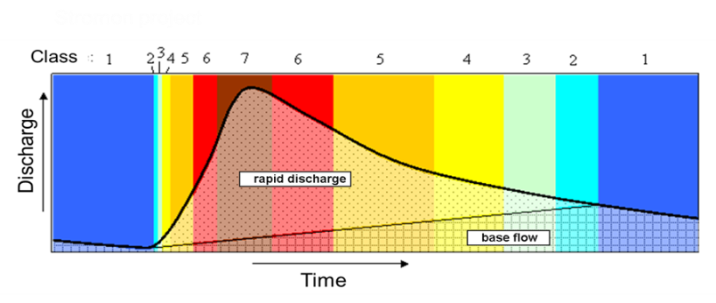
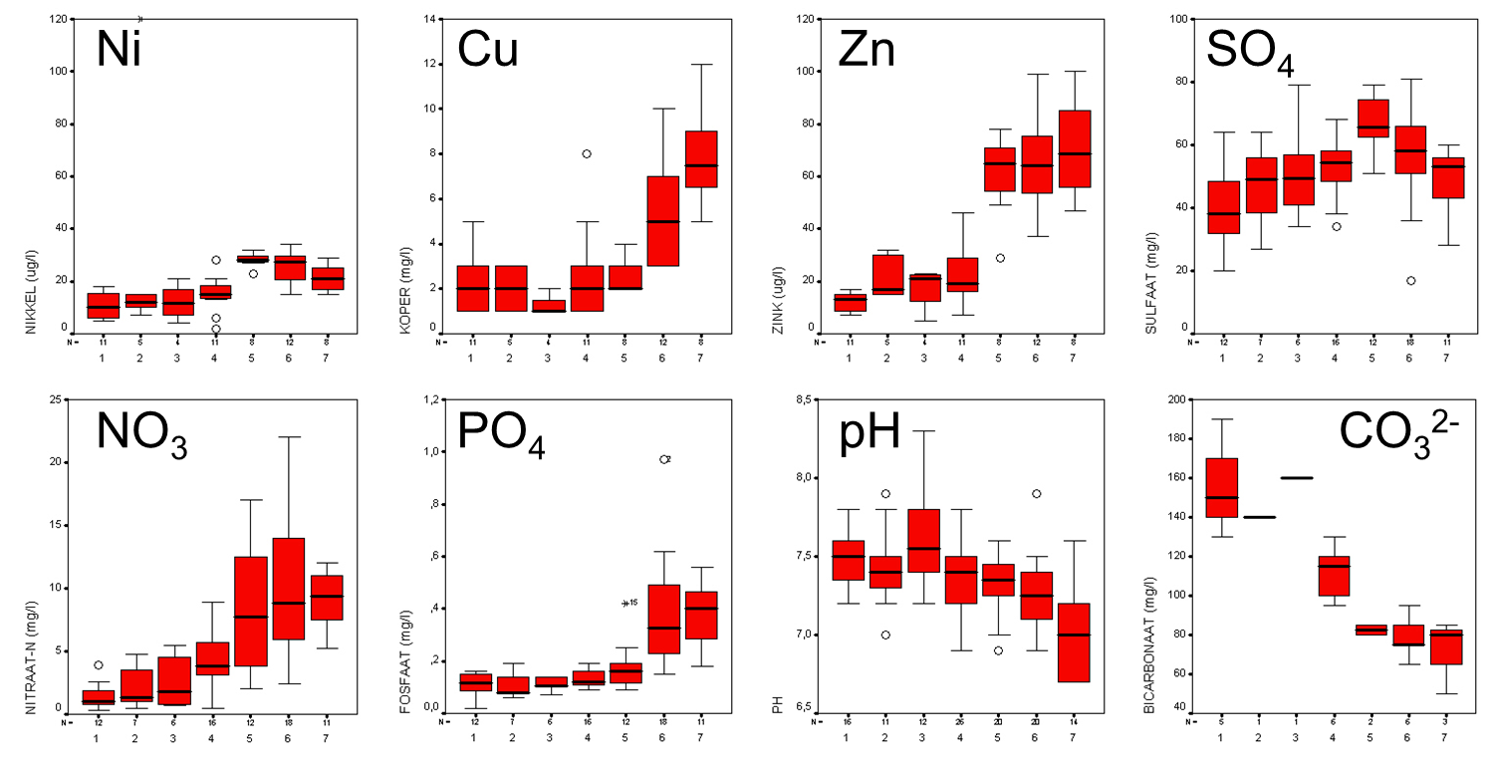
4. Nature and water quality
Interaction between groundwater and surface water:

Slide 23
5. Nature and climate change
What will happen to our climate? In 2050? 2100?

Slide 24
5. Nature and climate change

Slide 25
5. Nature and climate change

Slide 26
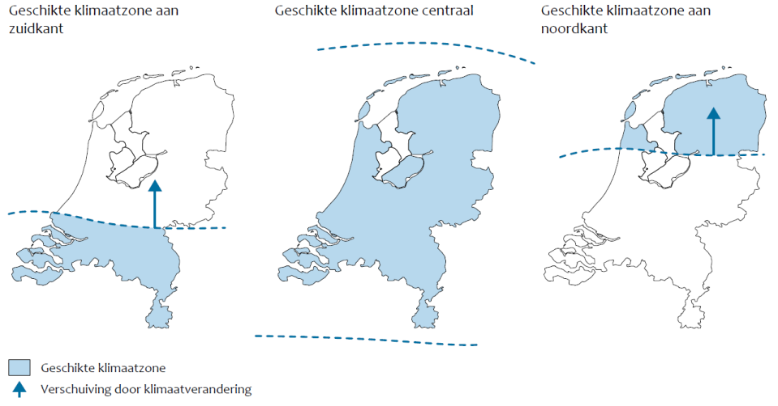
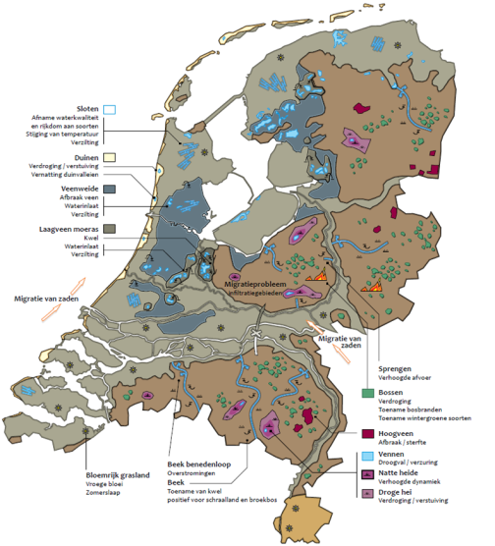
5. Nature and climate change
Different approaches for impact assessment
1. Envelop models
2. Models on Site conditions
3. Expert judgement
vulnerability
scetch map

Slide 27
5. Nature and climate change
Witte et al., 2012 Ecohydrological effects of climate change
Groundwater independent ecosystems (dry forest, heather, dunes)
Increase in drought stress
Increase in fire risk
More open vegetation
Increase in warm tolerant species
Rainfed wet ecosystems (bogs, wet heather, ponds)
W+ for peat bogs possibly critical (T too high, P-ET too low, dGXG too large)
Wet heather more desiccation, more mineralisation
Ponds: Increase in dry fall, more mineralisation

Slide 28
5. Nature and climate change
Witte et al., 2012 Ecohydrological effects of climate change
Ecosystems fed by upward seepage and surface water (brook valleys, fens, wet dune valleys)
Regional upward seepage areas relatively robust
Damage due to groundwater lowering (mineralisation)
Upward seepage increase?
In fens damage due to groundwater lowering, increase in mineralisation and more inlet of system alien water
Small surface waters (brooks, streams, ditches, lakes, ponds)
More dry fall (upper part of streams)
Increase in eutrophication ditches / lakes due to higher temp.
More inundation along streams (eutrophication )
More salinisation

Slide 29

5. Nature and climate change
Scetch map of
ecohydrological
effects
Witte et al., 2012
G
Wetter conditions
Increase in weather extremes
Some change in moisture deficit and water demand
W+
Wetter winters: more flooding
More frequent dry summers, lowering of water levels: more desiccation
Higer temperatures, stronger fluctuation in groundwaterlevels, increased mineralisation: peat areas under stress
Upward seepage increase/decrease? Effect on vegetation cover?
Big increase in moisture deficit and water demand

Slide 30
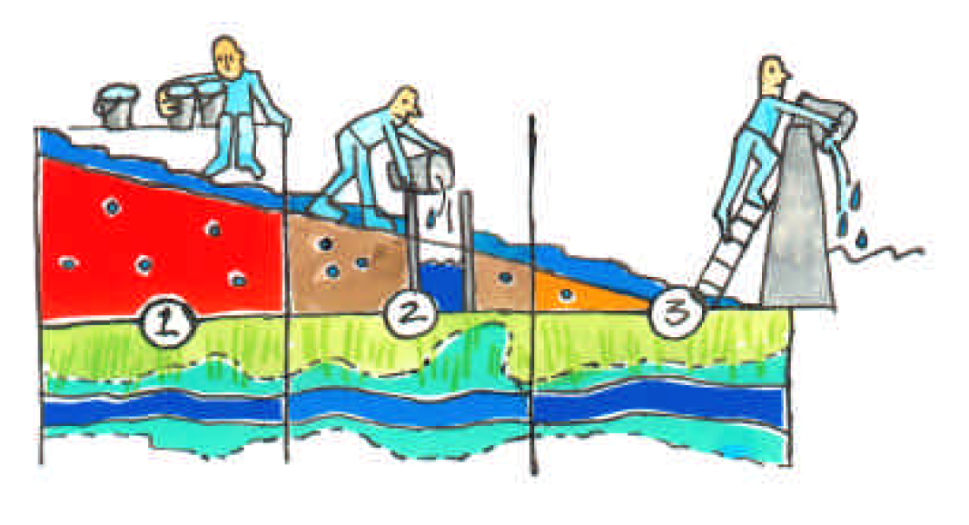
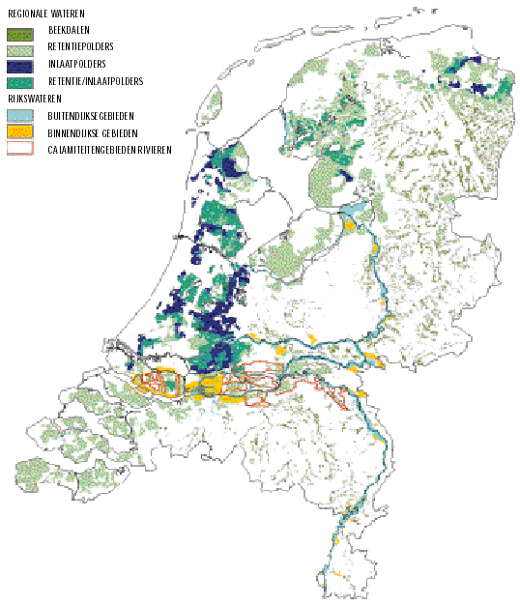
5. Nature and climate change
Climate adaptation: climate buffers
Water management for the 21st century
Potential water storage areas
Retain Store Remove
Water conservation
Water storage
Water release

Slide 31
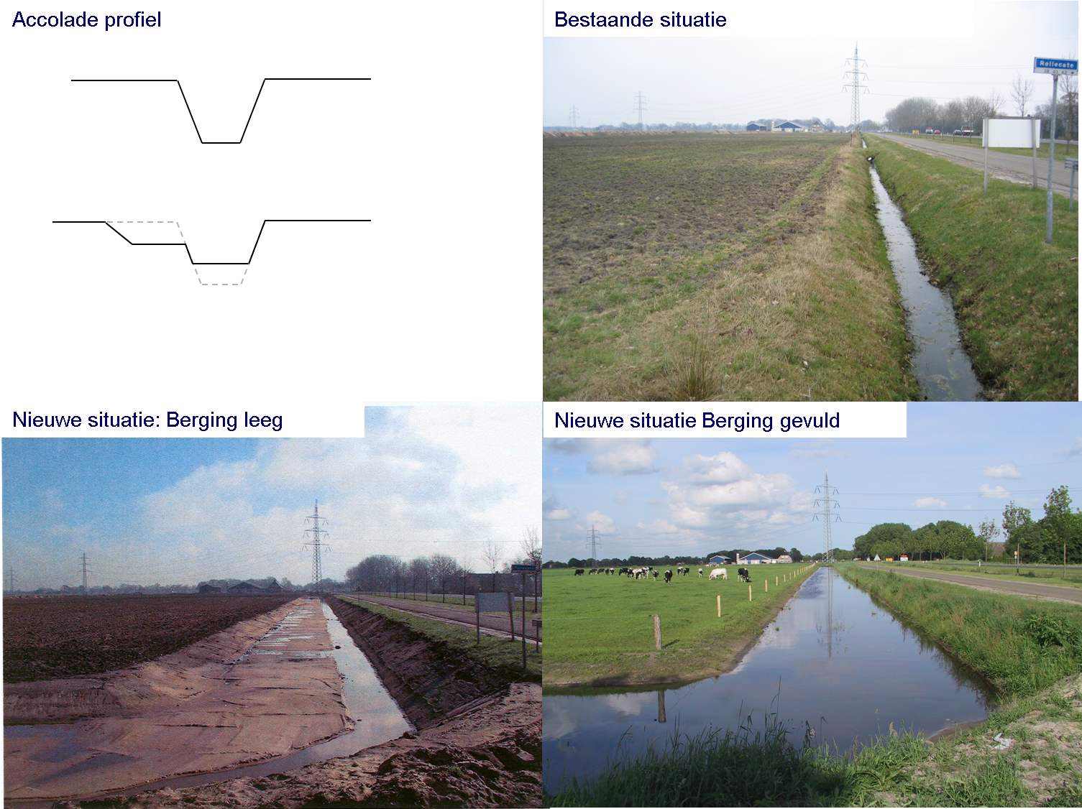
5. Nature and climate change
brace profile
Current situation
Climate adaptation: climate buffers
New situation: low storage
New situation: high storage

Slide 32
5. Nature and climate change
Climate adaptation: climate buffers
Effects of water storage on nature?
Runhaar et al., 2004
Inundation
Oxygen deficit
Increased mortality
due to oxygen deficiency
(drowning)
Input of toxic
compounds
Reduction
Increased mortality
due to intoxication
Input of sulphate
through surface water
sulphate
reduction
H₂S-
Formation
Input of nutriënts
(NPK) through surface
water
P-mobilistation
Increased production
vegetation (eutrophication)
Change in
species
composition
Water storage
Input of nutriënts
(NPK) through sediment
Decomposition of
organic matter
Input basics
through sediment
Increase pH
(alkalinity)
Input bicarbonate
through sediment
In/output of
Salt
(salinisation/sweetening)

Slide 33
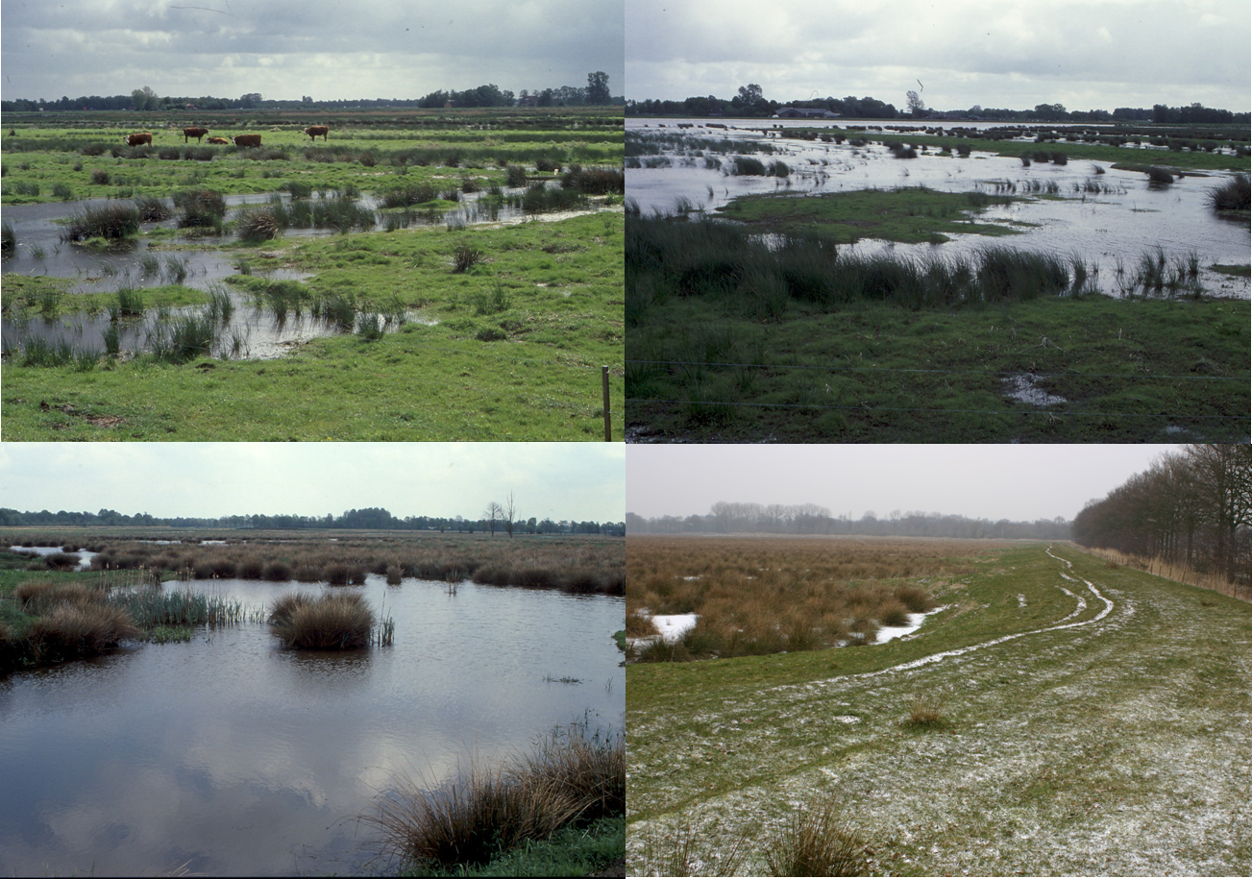
5. Nature and climate change
Climate adaptation: climate buffers
New nature areas: Yes please, but…

Slide 34
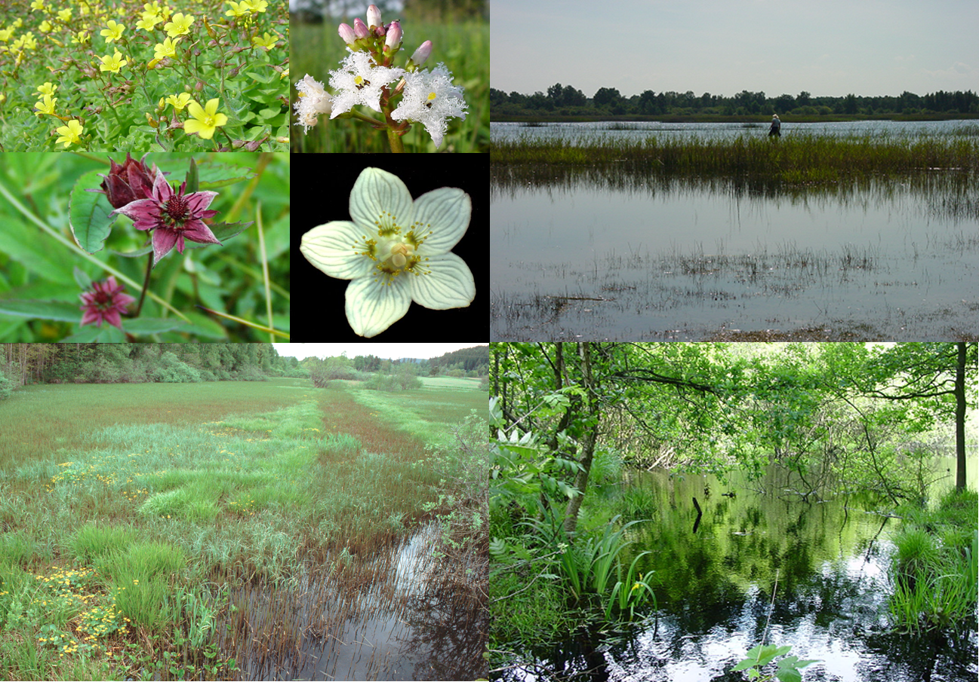
5. Nature and climate change
Climate adaptation: climate buffers
Existing nature areas:
No, unless…

Slide 35
6. Ecosystem services, management
What is the value of nature / ecosystems?

Slide 36
6. Ecosystem services, management
What is the value of nature / ecosystems?
Use value ( € )
Total economic value
Non use value ( € )
Intrinsic value ( - )
Ecosystems Goods & Services

Slide 37
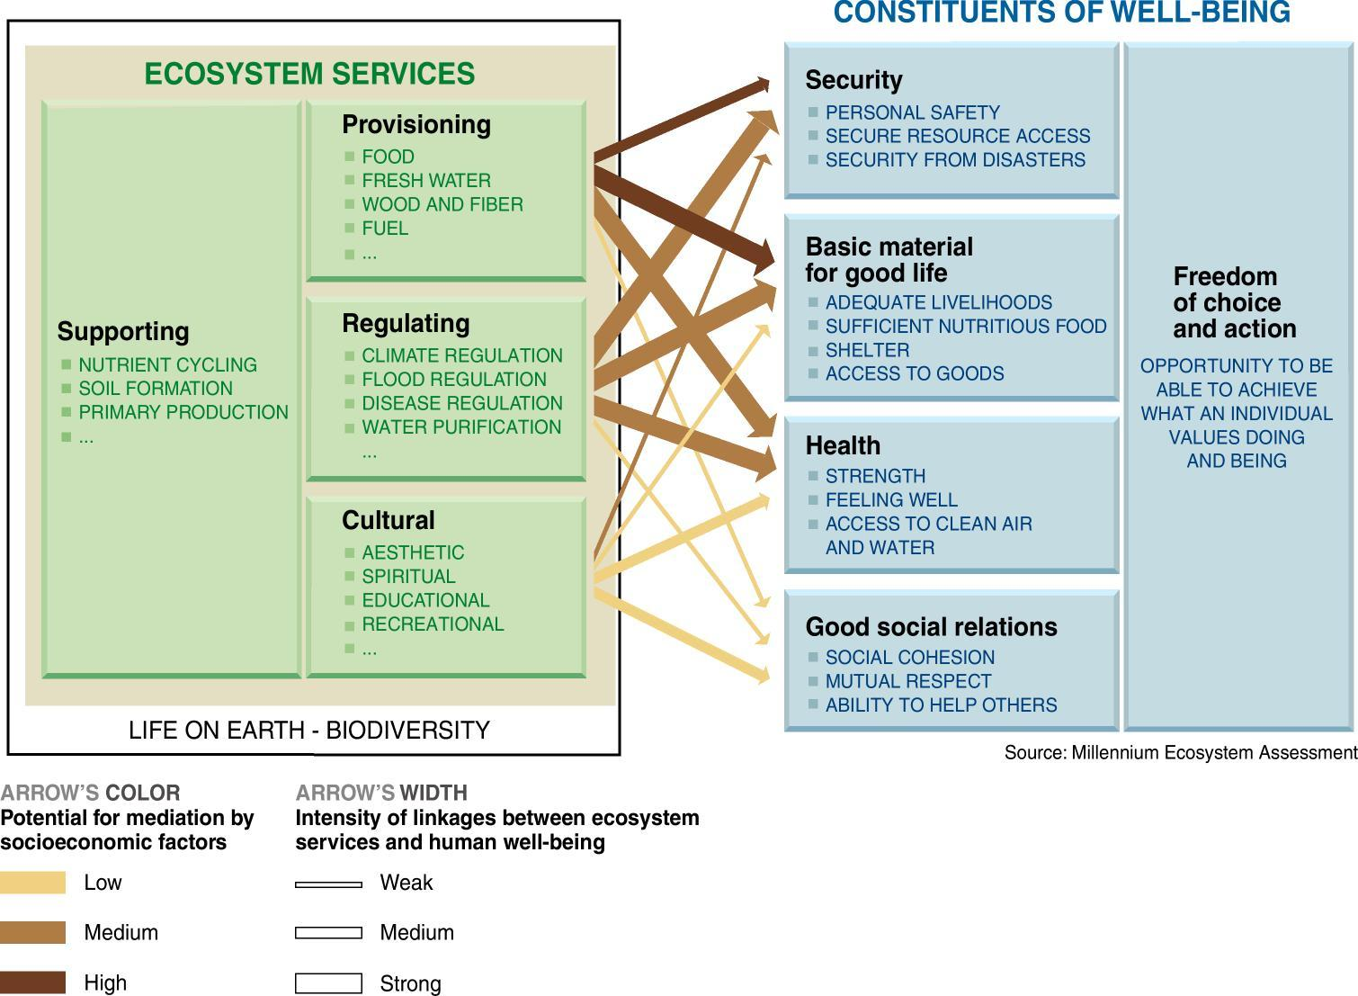
6. Ecosystem services, management

Slide 38
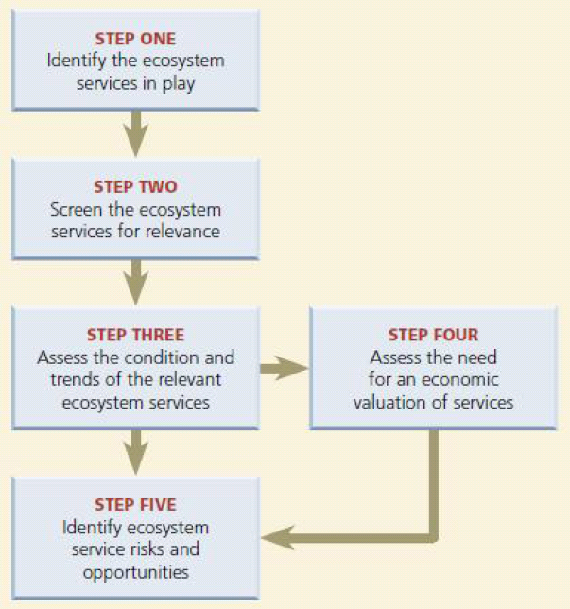
6. Ecosystem services, management
Framework for ecosystem assessment (Ranganathan, 2008)
Payement for
Ecosystem Services:
the beneficiary
pays

Slide 39
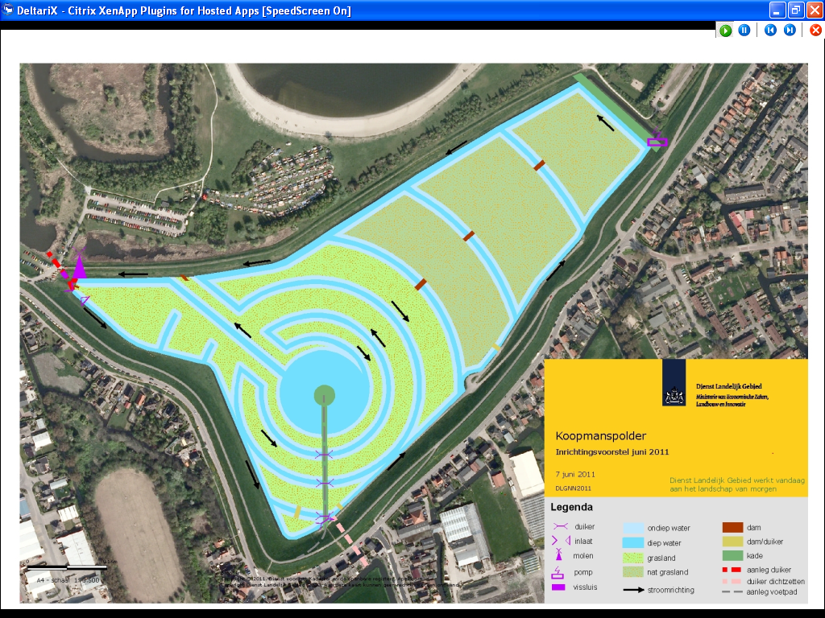
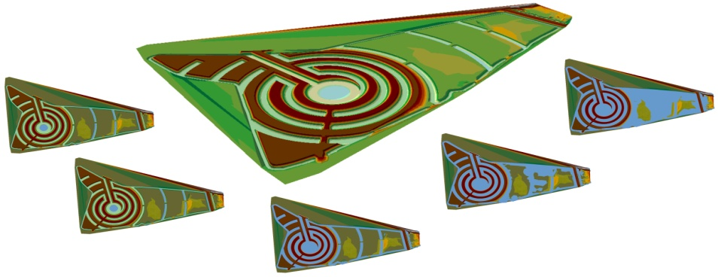
6. Ecosystem services, management

Slide 40
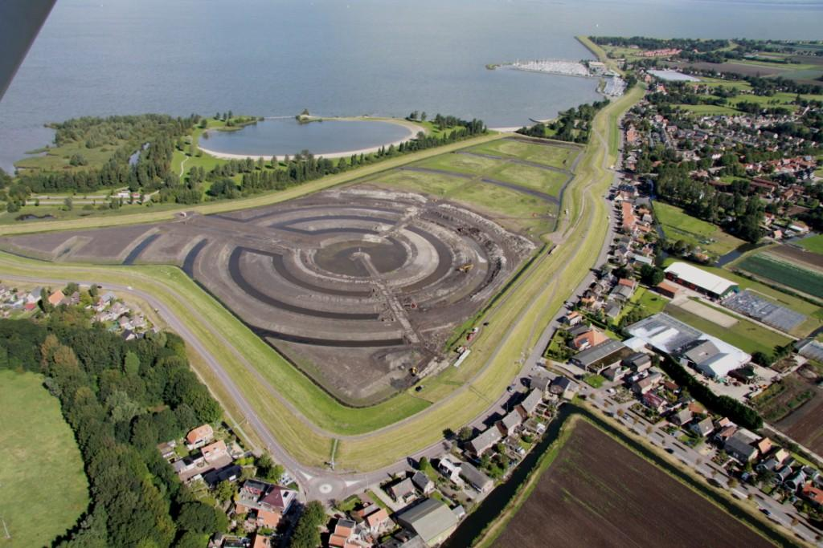
6. Ecosystem services, management

Slide 41
7. Knowledge development
Floods
Man & Society
Too much
Nature &
Watersystems
Too little
Too dirty
Water scarcity
& droughts
Water pollution

Slide 42
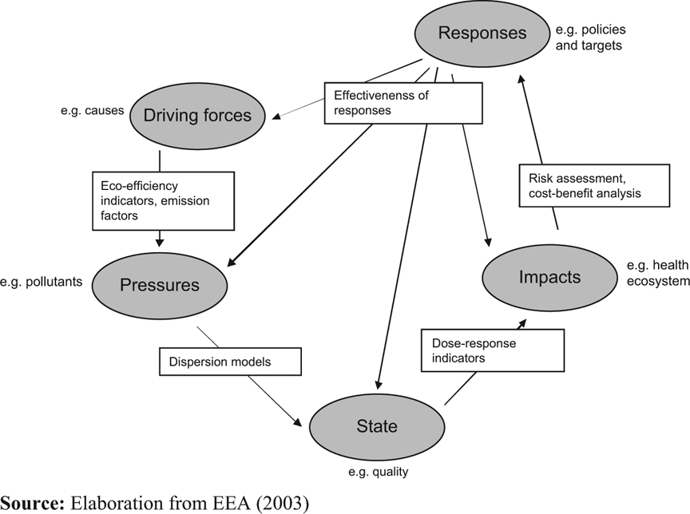
7. Knowledge development
objectives
Watersystem
analysis
monitoring
measures

Slide 43
8. Lessons learned
xx

